Slide 1
OF
FENSE
DE

Slide 2

$ whoami
Eduardo Vela
x.com/sirdarckcat
elgooG
"Vuln Stuff"

Slide 3
Agenda
Car Sales
Firefighting and Doctors
Wheel of Progress
Spot the Bug!
Name your price
Going Dark
Treasure Map
Bending the Curve
Appendix
Information Asymmetry
Acute/Chronic Responses
Security ROI
Unaffordable Mitigations
Hardening as Cost Saving
OffSec effects on Defense
Search space and cost
Defense/Offense Affordability
Hazard Control Hierarchy

Slide 4
Goal:
We will break down how
keeping exploit information secret
makes offense cheaper,
defense more expensive, and
how we can reverse this trend.

Slide 5
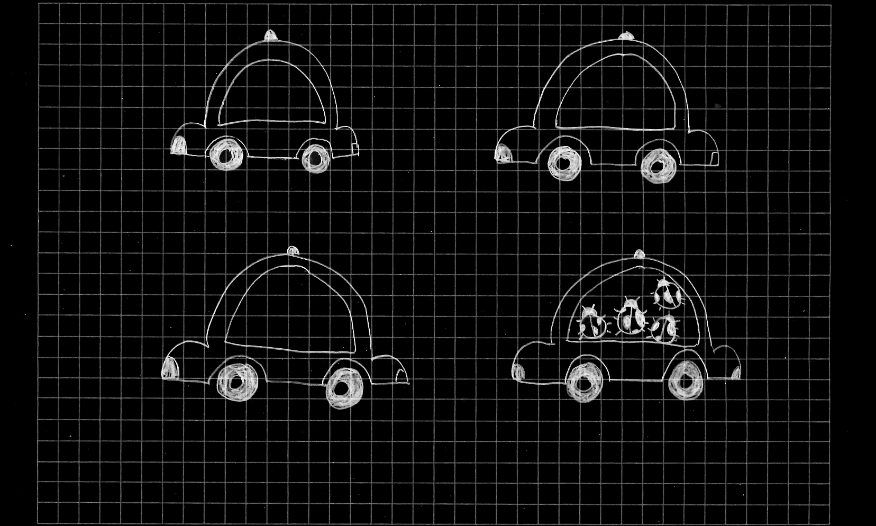

Slide 6
FOR SALE
$50,000

Slide 7
FOR SALE
FOR SALE
$50,000
$55,000

Slide 8
FOR SALE
FOR SALE
$50,000
$55,000
FOR SALE
$49,000

Slide 9
FOR SALE
FOR SALE
$50,000
$55,000
FOR SALE
FOR SALE
$49,000

Slide 10
FOR SALE
FOR SALE
$50,000
$55,000
FOR SALE
FOR SALE
$56,000
$49,000

Slide 11
🏦
DATE
2026/06/27
PAY TO THE ORDER OF
$
DOLLARS
car
Hackz
MEMO
🙾133726008000058 🙿988 🙿111 312🙿

Slide 12
🏦
DATE
2026/06/27
PAY TO THE ORDER OF
fifty two thousand and five hundred
$
52,500
DOLLARS
car
Hackz
MEMO
🙾133726008000058 🙿988 🙿111 312🙿

Slide 13
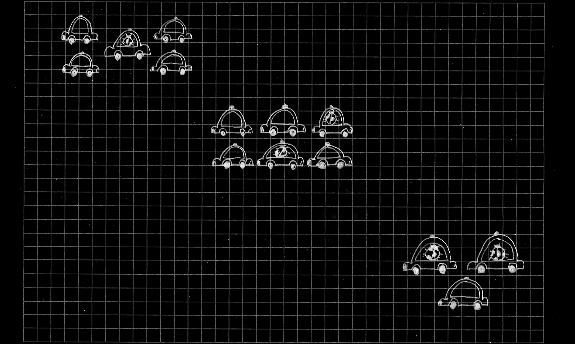
$ 52,500
1🐞/5🚗

Slide 14
$ 52,500
1🐞/5🚗
$
2🐞/6🚗

Slide 15
$ 52,500
1🐞/5🚗
$ 50,000
2🐞/6🚗

Slide 16
$ 52,500
1🐞/5🚗
$ 50,000
2🐞/6🚗
2🐞/3🚗

Slide 17
So how do we solve this?

Slide 18
Transparency

Slide 19
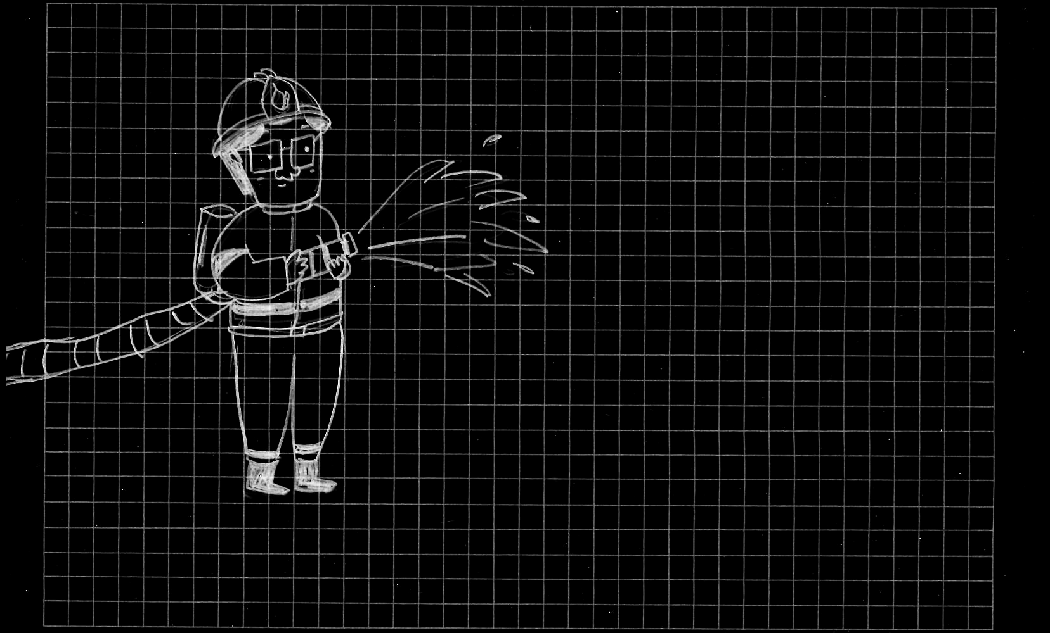

CVE
CVE
CVE
CVE
CVE
CVE
CVE
CVE

Slide 20


Slide 21
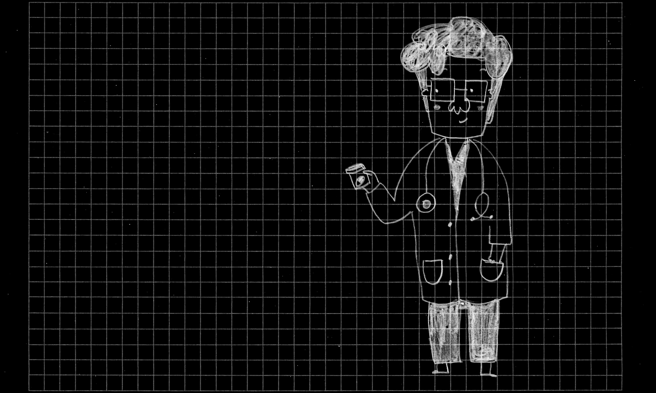






Slide 22
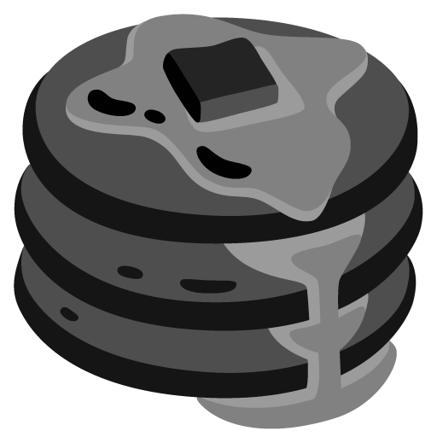









Slide 23






Slide 24

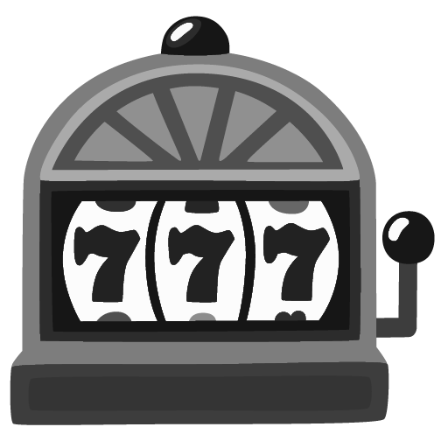







Slide 26
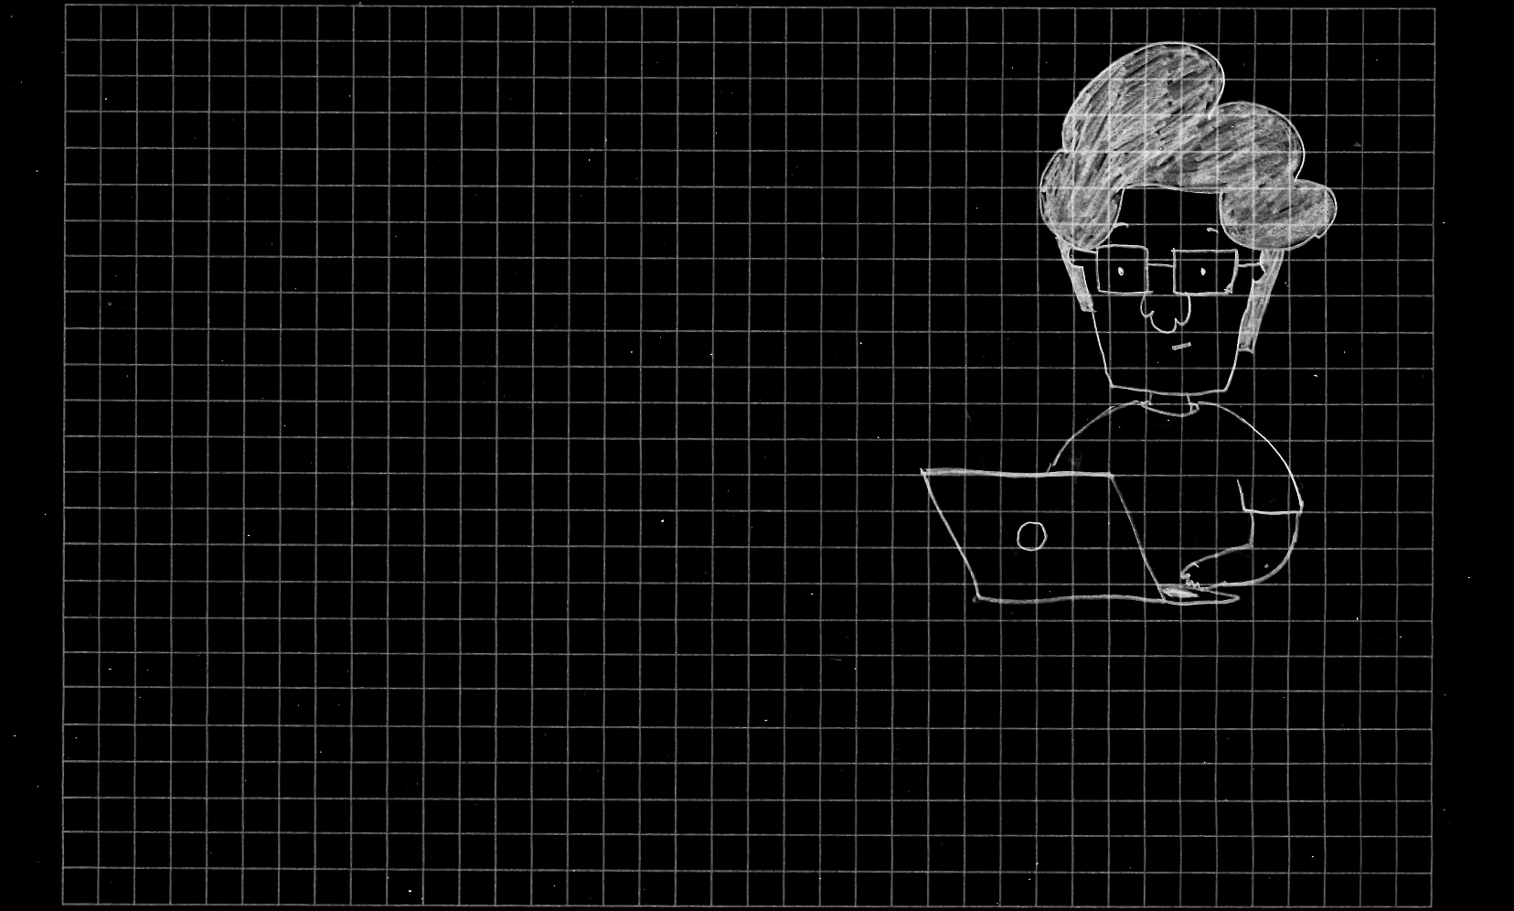

Features

Slide 27

Development Time

Slide 28

Maintenance

Slide 29

Latency

Slide 30

Functional Bugs

Slide 31

Performance

Slide 32

Capacity

Slide 33


Slide 34
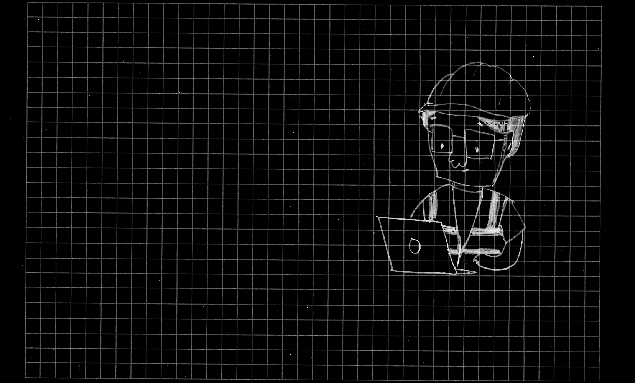


Slide 36


Slide 37


Slide 38


Slide 40


Slide 41
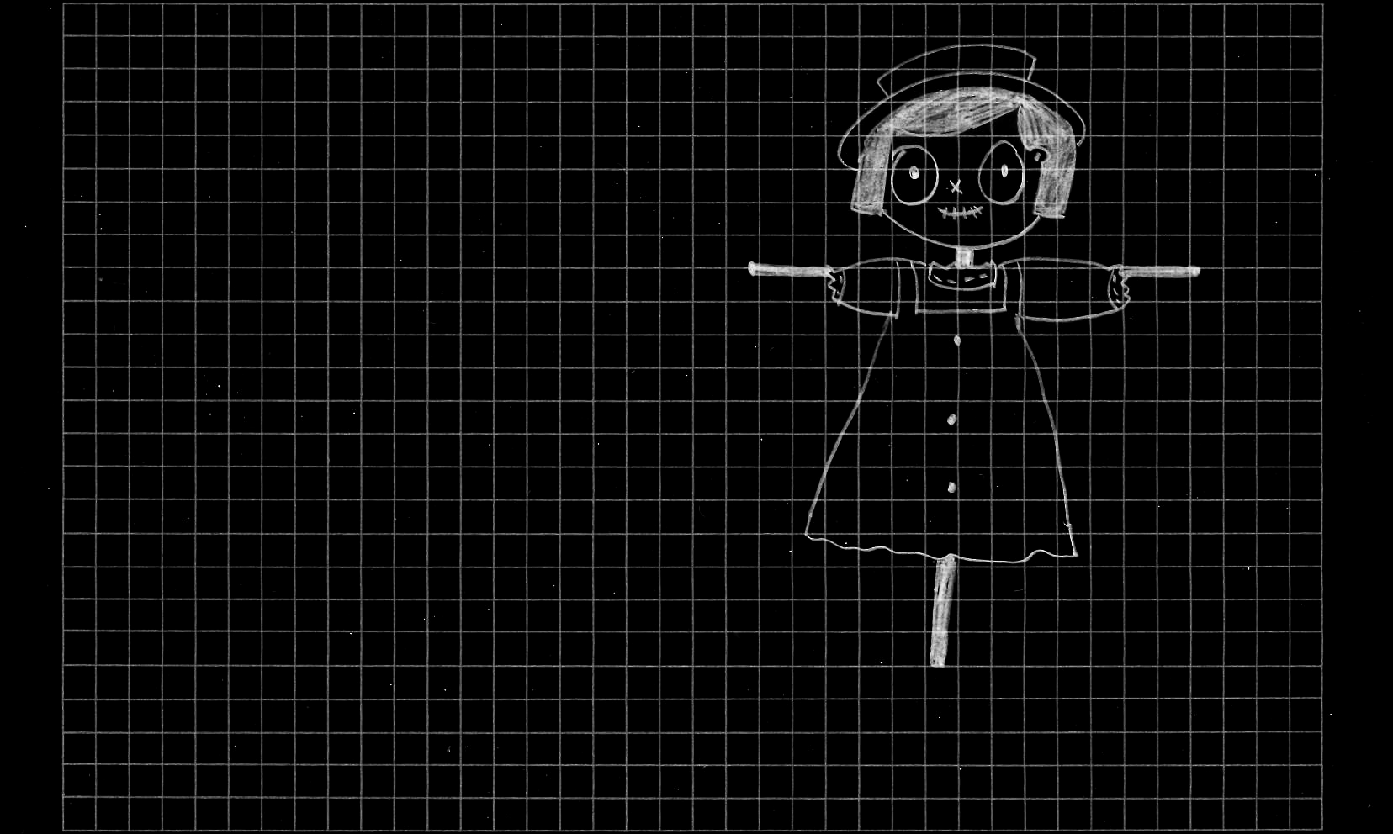
Spot The Bug
typedef struct {
int field;
} my_struct;
my_struct *x;
x = malloc(123);
x->field = 0x666;
free(x);
my_struct *y;
y = malloc(123);
y->field = 0;
x->field = 0x888;
if (y->field != 0)
{
ERROR();
}

Slide 42
Use After Free
typedef struct {
int field;
} my_struct;
my_struct *x;
x = malloc(123);
x->field = 0x666;
free(x);
my_struct *y;
y = malloc(123);
y->field = 0;
x->field = 0x888;
if (y->field != 0)
{
ERROR();
}

Slide 43
Use After Free
typedef struct {
int field;
} my_struct;

Slide 44
Use After Free
typedef struct {
int field;
} my_struct;
my_struct *x;
x = malloc(123);
x = 0x4000;
0x00: 00 00 00 00
0x04: 00 00 00 00
0x08: 00 00 00 00
0x10: 00 00 00 00
...

Slide 45
Use After Free
typedef struct {
int field;
} my_struct;
my_struct *x;
x = malloc(123);
x->field = 0x666;
x = 0x4000;
0x00: 66 06 00 00
0x04: 00 00 00 00
0x08: 00 00 00 00
0x10: 00 00 00 00
...

Slide 46
Use After Free
typedef struct {
int field;
} my_struct;
my_struct *x;
x = malloc(123);
x->field = 0x666;
free(x);
x = 0x4000;
0x00: 66 06 00 00
0x04: 00 00 00 00
0x08: 00 00 00 00
0x10: 00 00 00 00
...

Slide 47
Use After Free
typedef struct {
int field;
} my_struct;
my_struct *x;
x = malloc(123);
x->field = 0x666;
free(x);
my_struct *y;
y = malloc(123);
y = 0x4000;
x = 0x4000;
0x00: 66 06 00 00
0x04: 00 00 00 00
0x08: 00 00 00 00
0x10: 00 00 00 00
...

Slide 48
Use After Free
typedef struct {
int field;
} my_struct;
my_struct *x;
x = malloc(123);
x->field = 0x666;
free(x);
my_struct *y;
y = malloc(123);
y->field = 0;
y = 0x4000;
x = 0x4000;
0x00: 00 00 00 00
0x04: 00 00 00 00
0x08: 00 00 00 00
0x10: 00 00 00 00
...

Slide 49
Use After Free
typedef struct {
int field;
} my_struct;
my_struct *x;
x = malloc(123);
x->field = 0x666;
free(x);
my_struct *y;
y = malloc(123);
y->field = 0;
x->field = 0x888;
y = 0x4000;
x = 0x4000;
0x00: 88 08 00 00
0x04: 00 00 00 00
0x08: 00 00 00 00
0x10: 00 00 00 00
...

Slide 50
Use After Free
typedef struct {
int field;
} my_struct;
my_struct *x;
x = malloc(123);
x->field = 0x666;
free(x);
my_struct *y;
y = malloc(123);
y->field = 0;
x->field = 0x888;
if (y->field != 0)
{
ERROR();
}
y = 0x4000;
x = 0x4000;
0x00: 88 08 00 00
0x04: 00 00 00 00
0x08: 00 00 00 00
0x10: 00 00 00 00
...

Slide 51
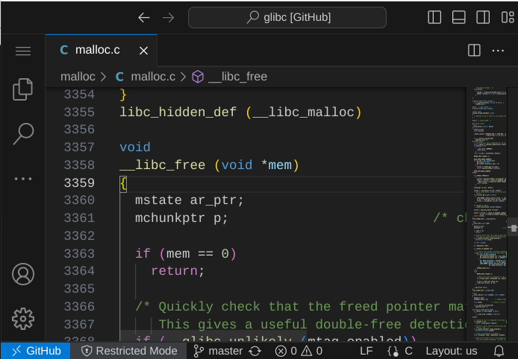
Use After Free

Slide 52
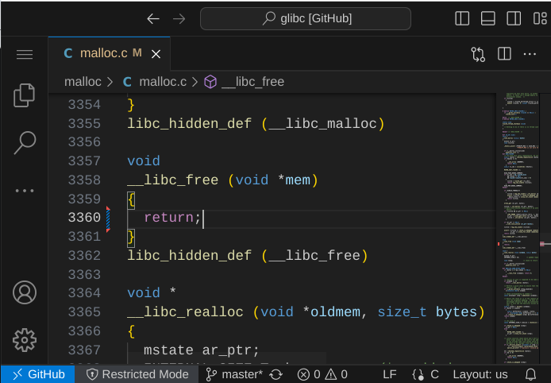
Use After Free

Slide 53
Use After Free
typedef struct {
int field;
} my_struct;
my_struct *x;
x = malloc(123);
x->field = 0x666;
x = 0x4000;
0x00: 66 06 00 00
0x04: 00 00 00 00
0x08: 00 00 00 00
0x10: 00 00 00 00
...

Slide 54
Use After Free
typedef struct {
int field;
} my_struct;
my_struct *x;
x = malloc(123);
x->field = 0x666;
free(x);
x = 0x4000;
0x00: 66 06 00 00
0x04: 00 00 00 00
0x08: 00 00 00 00
0x10: 00 00 00 00
...

Slide 55
Use After Free
typedef struct {
int field;
} my_struct;
my_struct *x;
x = malloc(123);
x->field = 0x666;
free(x);
my_struct *y;
y = malloc(123);
y->field = 0;
x = 0x4000;
0x00: 66 06 00 00
0x04: 00 00 00 00
0x08: 00 00 00 00
0x10: 00 00 00 00
...
y = 0x5000;
0x00: 00 00 00 00
0x04: 00 00 00 00
0x08: 00 00 00 00
0x10: 00 00 00 00
...

Slide 56
Use After Free
typedef struct {
int field;
} my_struct;
my_struct *x;
x = malloc(123);
x->field = 0x666;
free(x);
my_struct *y;
y = malloc(123);
y->field = 0;
x->field = 0x888;
x = 0x4000;
0x00: 88 08 00 00
0x04: 00 00 00 00
0x08: 00 00 00 00
0x10: 00 00 00 00
...
y = 0x5000;
0x00: 00 00 00 00
0x04: 00 00 00 00
0x08: 00 00 00 00
0x10: 00 00 00 00
...

Slide 57
Use After Free
typedef struct {
int field;
} my_struct;
my_struct *x;
x = malloc(123);
x->field = 0x666;
free(x);
my_struct *y;
y = malloc(123);
y->field = 0;
x->field = 0x888;
if (y->field != 0)
{
ERROR();
}
x = 0x4000;
0x00: 88 08 00 00
0x04: 00 00 00 00
0x08: 00 00 00 00
0x10: 00 00 00 00
...
y = 0x5000;
0x00: 00 00 00 00
0x04: 00 00 00 00
0x08: 00 00 00 00
0x10: 00 00 00 00
...

Slide 58
Use After Free
typedef struct {
int field;
} my_struct;
my_struct *x;
x = malloc(123);
x->field = 0x666;
free(x);
my_struct *y;
y = malloc(123);
y->field = 0;
x->field = 0x888;
if (y->field != 0)
{
ERROR();
}
typedef struct {
int field;
} my_struct;
my_struct *x;
x = malloc(123);
x->field = 0x666;
free(x);
my_struct *y;
y = malloc(123);
y->field = 0;
x->field = 0x888;
if (y->field != 0)
{
ERROR();
}
x = 0x4000;
x = 0x4000;
0x00: 88 08 00 00
0x04: 00 00 00 00
0x08: 00 00 00 00
0x10: 00 00 00 00
...
0x00: 88 08 00 00
0x04: 00 00 00 00
0x08: 00 00 00 00
0x10: 00 00 00 00
...
y = 0x5000;
y = 0x5000;
0x00: 00 00 00 00
0x04: 00 00 00 00
0x08: 00 00 00 00
0x10: 00 00 00 00
...
0x00: 00 00 00 00
0x04: 00 00 00 00
0x08: 00 00 00 00
0x10: 00 00 00 00
...

Slide 59
Use After Free
typedef struct {
int field;
} my_struct;
my_struct *x;
x = malloc(123);
x->field = 0x666;
free(x);
my_struct *y;
y = malloc(123);
y->field = 0;
x->field = 0x888;
if (y->field != 0)
{
ERROR();
}
typedef struct {
int field;
} my_struct;
my_struct *x;
x = malloc(123);
x->field = 0x666;
free(x);
my_struct *y;
y = malloc(123);
y->field = 0;
x->field = 0x888;
if (y->field != 0)
{
ERROR();
}
typedef struct {
int field;
} my_struct;
my_struct *x;
x = malloc(123);
x->field = 0x666;
free(x);
my_struct *y;
y = malloc(123);
y->field = 0;
x->field = 0x888;
if (y->field != 0)
{
ERROR();
}
typedef struct {
int field;
} my_struct;
my_struct *x;
x = malloc(123);
x->field = 0x666;
free(x);
my_struct *y;
y = malloc(123);
y->field = 0;
x->field = 0x888;
if (y->field != 0)
{
ERROR();
}
typedef struct {
int field;
} my_struct;
my_struct *x;
x = malloc(123);
x->field = 0x666;
free(x);
my_struct *y;
y = malloc(123);
y->field = 0;
x->field = 0x888;
if (y->field != 0)
{
ERROR();
}
x = 0x4000;
x = 0x4000;
x = 0x4000;
x = 0x4000;
x = 0x4000;
x = 0x4000;
x = 0x4000;
x = 0x4000;
x = 0x4000;
0x00: 88 08 00 00
0x04: 00 00 00 00
0x08: 00 00 00 00
0x10: 00 00 00 00
...
0x00: 88 08 00 00
0x04: 00 00 00 00
0x08: 00 00 00 00
0x10: 00 00 00 00
...
0x00: 88 08 00 00
0x04: 00 00 00 00
0x08: 00 00 00 00
0x10: 00 00 00 00
...
0x00: 88 08 00 00
0x04: 00 00 00 00
0x08: 00 00 00 00
0x10: 00 00 00 00
...
0x00: 88 08 00 00
0x04: 00 00 00 00
0x08: 00 00 00 00
0x10: 00 00 00 00
...
0x00: 88 08 00 00
0x04: 00 00 00 00
0x08: 00 00 00 00
0x10: 00 00 00 00
...
0x00: 88 08 00 00
0x04: 00 00 00 00
0x08: 00 00 00 00
0x10: 00 00 00 00
...
0x00: 88 08 00 00
0x04: 00 00 00 00
0x08: 00 00 00 00
0x10: 00 00 00 00
...
0x00: 88 08 00 00
0x04: 00 00 00 00
0x08: 00 00 00 00
0x10: 00 00 00 00
...
y = 0x5000;
y = 0x5000;
y = 0x5000;
y = 0x5000;
y = 0x5000;
y = 0x5000;
y = 0x5000;
y = 0x5000;
y = 0x5000;
0x00: 00 00 00 00
0x04: 00 00 00 00
0x08: 00 00 00 00
0x10: 00 00 00 00
...
0x00: 00 00 00 00
0x04: 00 00 00 00
0x08: 00 00 00 00
0x10: 00 00 00 00
...
0x00: 00 00 00 00
0x04: 00 00 00 00
0x08: 00 00 00 00
0x10: 00 00 00 00
...
0x00: 00 00 00 00
0x04: 00 00 00 00
0x08: 00 00 00 00
0x10: 00 00 00 00
...
0x00: 00 00 00 00
0x04: 00 00 00 00
0x08: 00 00 00 00
0x10: 00 00 00 00
...
0x00: 00 00 00 00
0x04: 00 00 00 00
0x08: 00 00 00 00
0x10: 00 00 00 00
...
0x00: 00 00 00 00
0x04: 00 00 00 00
0x08: 00 00 00 00
0x10: 00 00 00 00
...
0x00: 00 00 00 00
0x04: 00 00 00 00
0x08: 00 00 00 00
0x10: 00 00 00 00
...
0x00: 00 00 00 00
0x04: 00 00 00 00
0x08: 00 00 00 00
0x10: 00 00 00 00
...

Slide 60
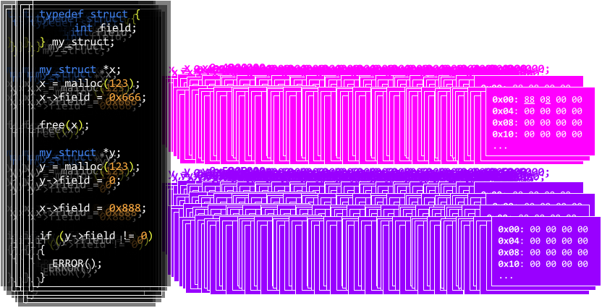
Use After Free

Slide 62
Is it worth it?

Slide 64



Slide 65



Slide 66
How much would you spend to respond?

Slide 67
max spend
actual spend
min spend

Slide 68
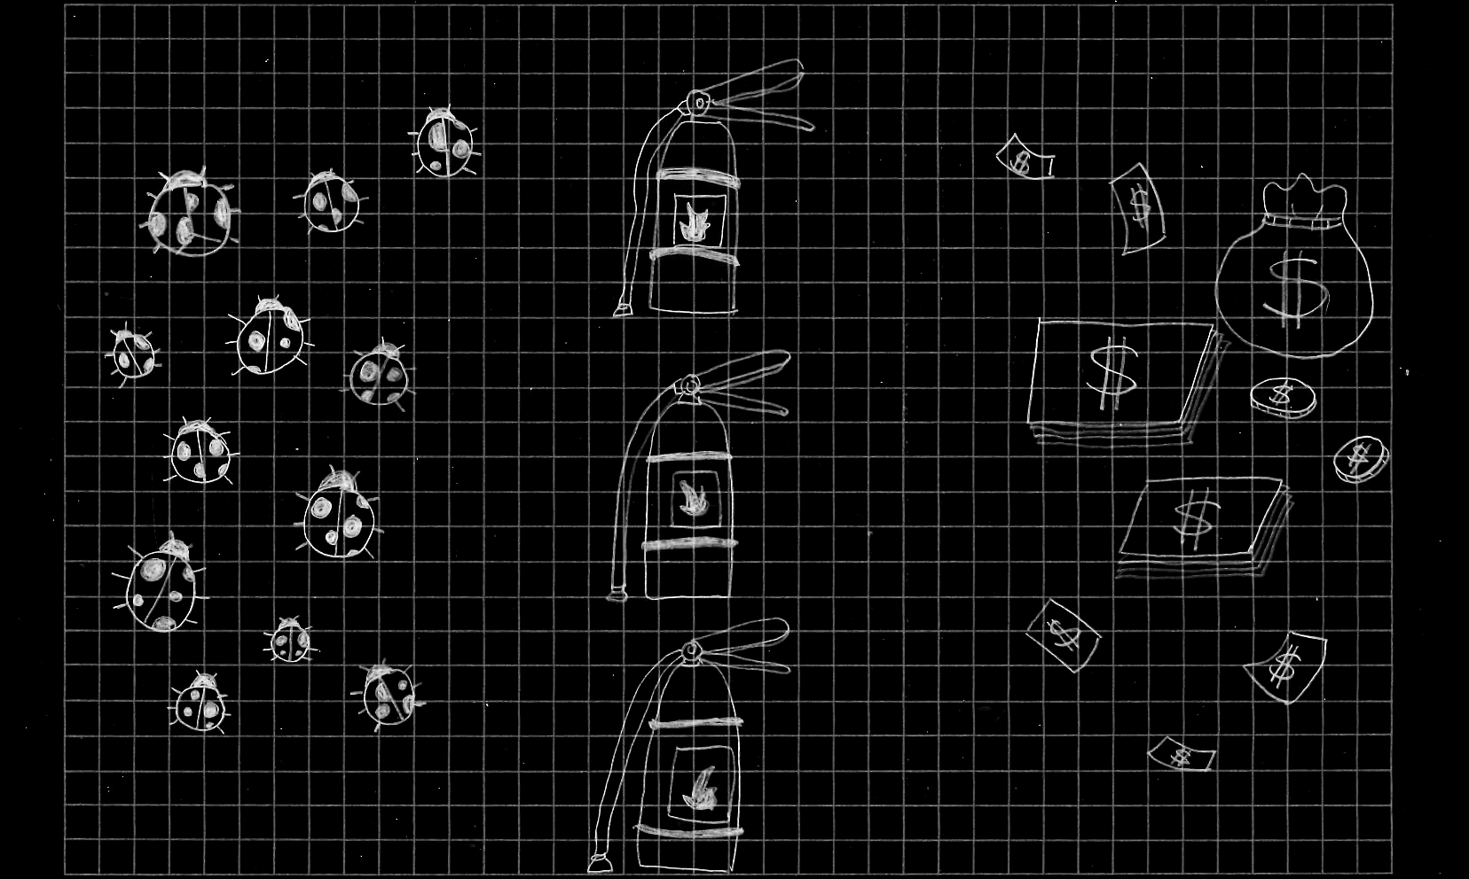
max spend
Hypothetical maximum annual cost that could be justifiably paid for responding to incidents
actual spend
Actual average annual cost paid for past responses
min spend
Minimum cost that could be paid, if controls are in place and if they are effective (opportunity)

Slide 69
max spend
actual spend
min spend

Slide 70
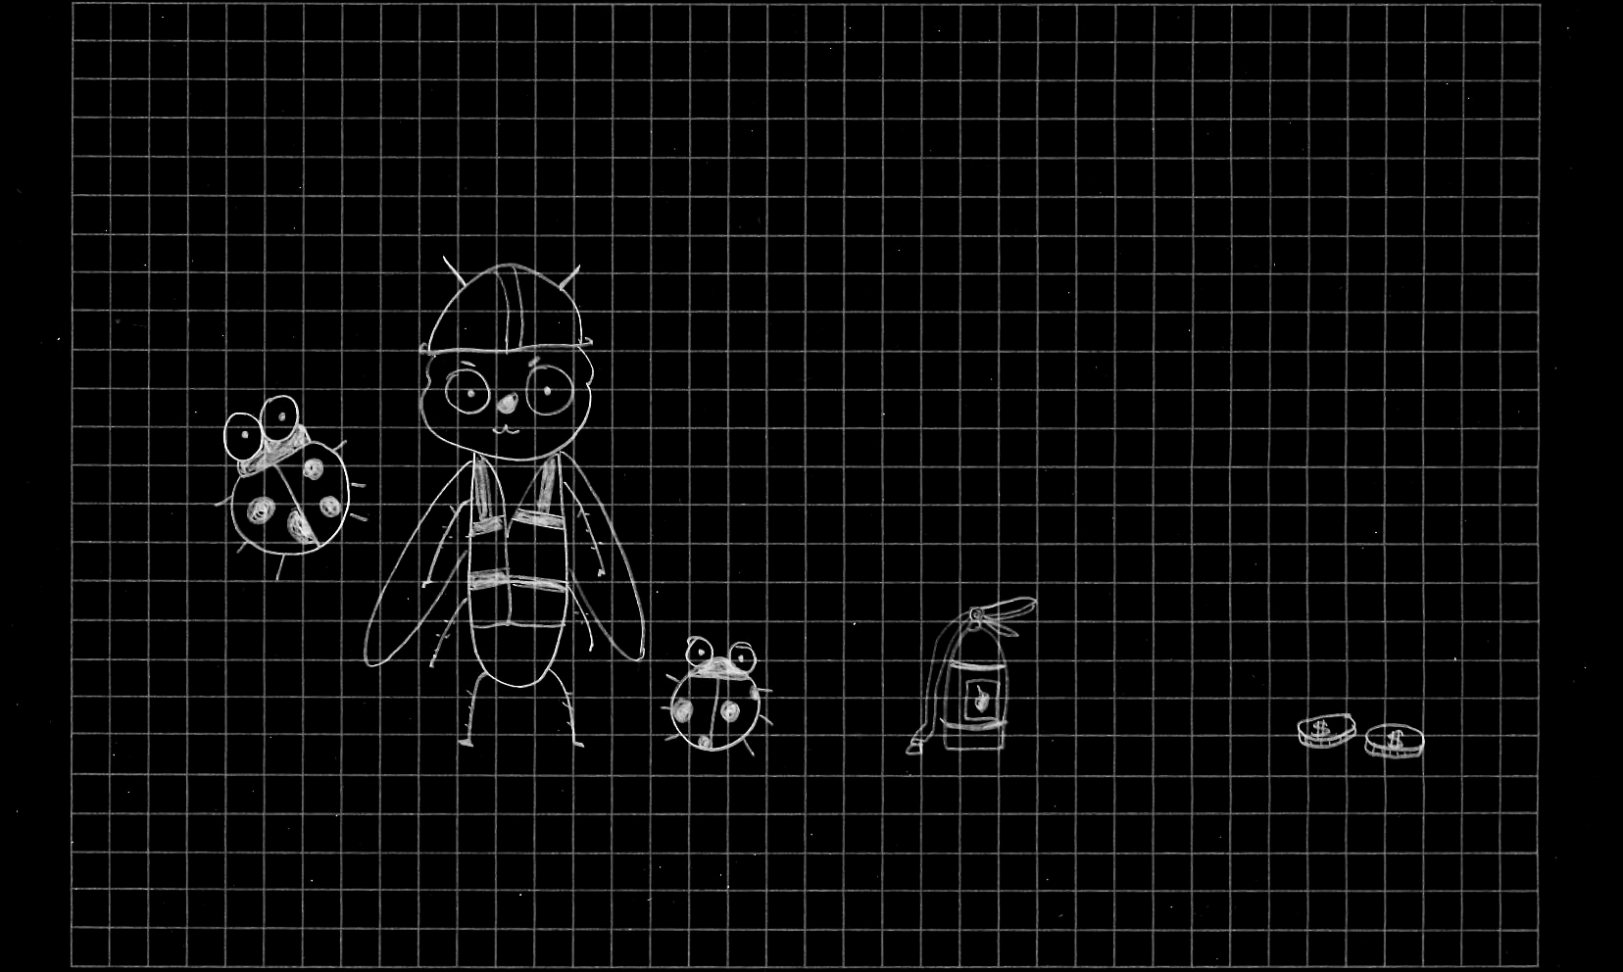
max spend
actual spend
min spend

Slide 71
Issue | First Exploited | Description | Exploit requires V8 Sandbox Bypass | Exploit requires JIT compilation
41490332 | ITW | Incorrect fast-path for JS property deletion in runtime | Yes | Probably
40941600 | V8CTF | Type confusion after promise resolution in combination with async stack traces | Yes | No
41482183 | V8CTF | Incorrect structural optimization in Turboshaft | Yes | Yes
41488920 | V8CTF | UaF in Maglev during object creation | Yes | Yes
330760873 | Pwn2Own | Out-of-bounds access in JS enum cache | Yes | Yes
330588502 | Pwn2Own | Incorrect parsing of Wasm Types | Yes | Probably Not
330759272 | Pwn2Own | Unclear ownership of DOMArrayBuffer | Yes | No
330563095* | Pwn2Own | WebCodec ArrayBuffer UaF | Yes | N/A
323694592 | V8CTF | Signature mismatch in specialized wasm-to-js wrappers | No˟ | Probably
339458194 | ITW | Wrong handling of Wasm Structs in JavaScript runtime | Yes | No
340221135 | ITW | Incorrect handling of JS imports in Maglev-generated code | Yes | Yes
341663589 | ITW | Incorrect parsing of JavaScript code leads to type confusion | Yes | No
339736513 | V8CTF | Wrong handling of Wasm Structs in JavaScript runtime | Yes | No
Notes:
https://x.com/5aelo/status/1799108578906931550?t=B5jSYTU1k13z3AhifHIvvQ&s=19

Slide 72
Issue | First Exploited | Description | Exploit requires V8 Sandbox Bypass | Exploit requires JIT compilation
41490332 | ITW | Incorrect fast-path for JS property deletion in runtime | Yes | Probably
40941600 | V8CTF | Type confusion after promise resolution in combination with async stack traces | Yes | No
41482183 | V8CTF | Incorrect structural optimization in Turboshaft | Yes | Yes
41488920 | V8CTF | UaF in Maglev during object creation | Yes | Yes
330760873 | Pwn2Own | Out-of-bounds access in JS enum cache | Yes | Yes
330588502 | Pwn2Own | Incorrect parsing of Wasm Types | Yes | Probably Not
330759272 | Pwn2Own | Unclear ownership of DOMArrayBuffer | Yes | No
330563095* | Pwn2Own | WebCodec ArrayBuffer UaF | Yes | N/A
323694592 | V8CTF | Signature mismatch in specialized wasm-to-js wrappers | No˟ | Probably
339458194 | ITW | Wrong handling of Wasm Structs in JavaScript runtime | Yes | No
340221135 | ITW | Incorrect handling of JS imports in Maglev-generated code | Yes | Yes
341663589 | ITW | Incorrect parsing of JavaScript code leads to type confusion | Yes | No
339736513 | V8CTF | Wrong handling of Wasm Structs in JavaScript runtime | Yes | No
Notes:
https://x.com/5aelo/status/1799108578906931550?t=B5jSYTU1k13z3AhifHIvvQ&s=19

Slide 73

Going Dark
Unfortunately, the law hasn’t kept pace with technology, and this disconnect has created a significant public safety problem. We call it “Going Dark,” and what it means is this: Those charged with protecting our people aren’t always able to access the evidence we need to prosecute crime and prevent terrorism even with lawful authority. We have the legal authority to intercept and access communications and information pursuant to court order, but we often lack the technical ability to do so.
NYtimes
Notes:
Going Dark: Are Technology, Privacy, and Public Safety on a Collision Course? — FBI
https://www.nytimes.com/2015/11/19/us/politics/fbi-director-repeats-call-that-ability-to-read-encrypted-messages-is-crucial.html

Slide 74




Slide 75


Slide 76




Slide 78


Slide 79


Slide 81
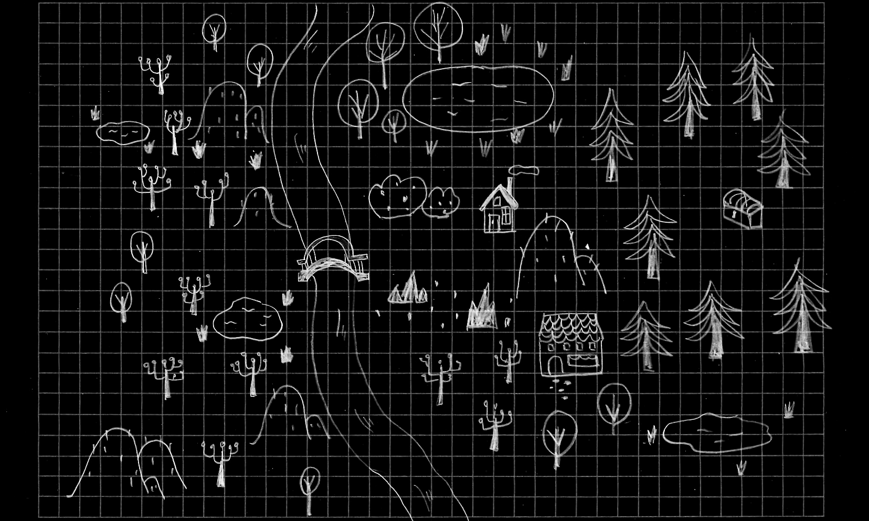

Slide 90


Slide 91


Slide 92


Slide 94







Slide 95
$
More Demand
More players

Slide 96
$
Less Supply
Making 0day harder

Slide 97


Very expensive
Very cheap
Very easy
Very difficult

Slide 98
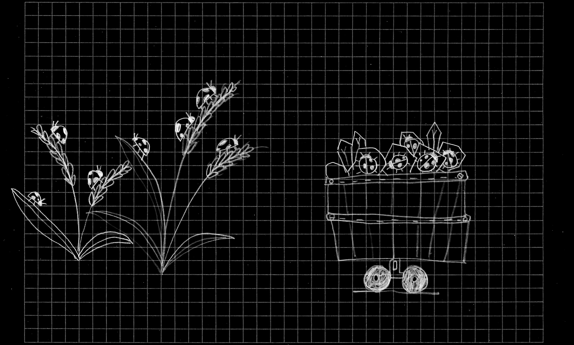
How can we increase OFFENSE cost without increasing DEFENSE cost?

Slide 99
Transparency

Slide 102
Defense
value
worth it
cost
not worth it
time

Slide 104



Slide 105
Vulnerability "clusters" (eg, buggy features)
Exploitation techniques (eg, winning race bugs)
Exploitation primitives (eg, structures, gadgets)

Slide 106
Vulnerability "clusters" (eg, buggy features)
Exploitation techniques (eg, winning race bugs)
Exploitation primitives (eg, structures, gadgets)
Vulnerability "clusters" (eg, buggy features)
Exploitation techniques (eg, winning race bugs)
Exploitation primitives (eg, structures, gadgets)

Slide 109
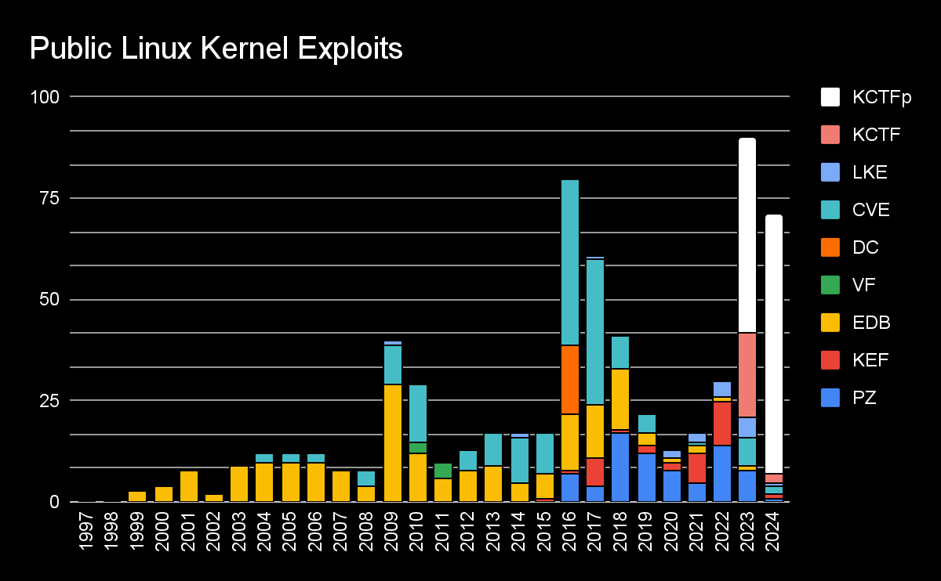

Slide 111
$
More Supply
Public exploit info

Slide 112
$
Less Demand
Lower quality / value

Slide 113
Offense
price
cost
profitable
not profitable
time

Slide 114
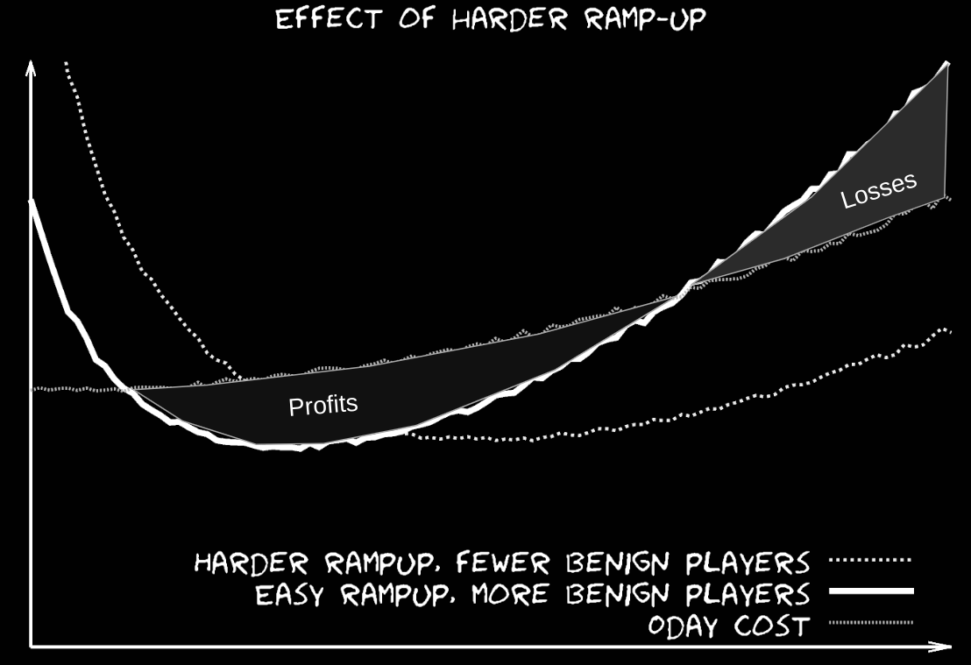
Repeated vs. single-round games in security Halvar Flake, BSides Zurich 2017
time

Slide 115
Goal:
We wanted to break down how
keeping exploit information secret
makes offense cheaper,
defense more expensive, and
how we can reverse this trend.

Slide 116
Conclusion:
Transparency can help {
buyers differentiate secure products,
defenders quantify mitigation value,
increase the cost of offensive security,
lower the cost of defensive security
}

Slide 117
Summary:
Car Sales
Firefighting and Doctors
Wheel of Progress
Spot the Bug!
Name your price
Going Dark
Treasure Map
Bending the Curve
Appendix
Information Asymmetry
Acute/Chronic Responses
Security ROI
Unaffordable Mitigations
Hardening as Cost Saving
OffSec effects on Defense
Search space and cost
Defense/Offense Affordability
Hazard Control Hierarchy

Slide 118
Appendix
If you are reading this, that means I went through >100 slides in <45 mins.. yikes!

Slide 119
Offense Goals:
Defense Goals:
time to find bug
time to deploy
time to fix
time to find vuln
time to introduce bug
time to find bug
time to find vuln
time to exploit
Bug Introduced
shelf life
Fix Deployed
time to implement mitigation
time to deploy mitigation
Mitigation Deployed
Time

Slide 120
Elimination
Substitution
Hierarchy of Controls
Isolation
Policy
DC

Slide 121
time to
introduce
bug
Elimination

Slide 122
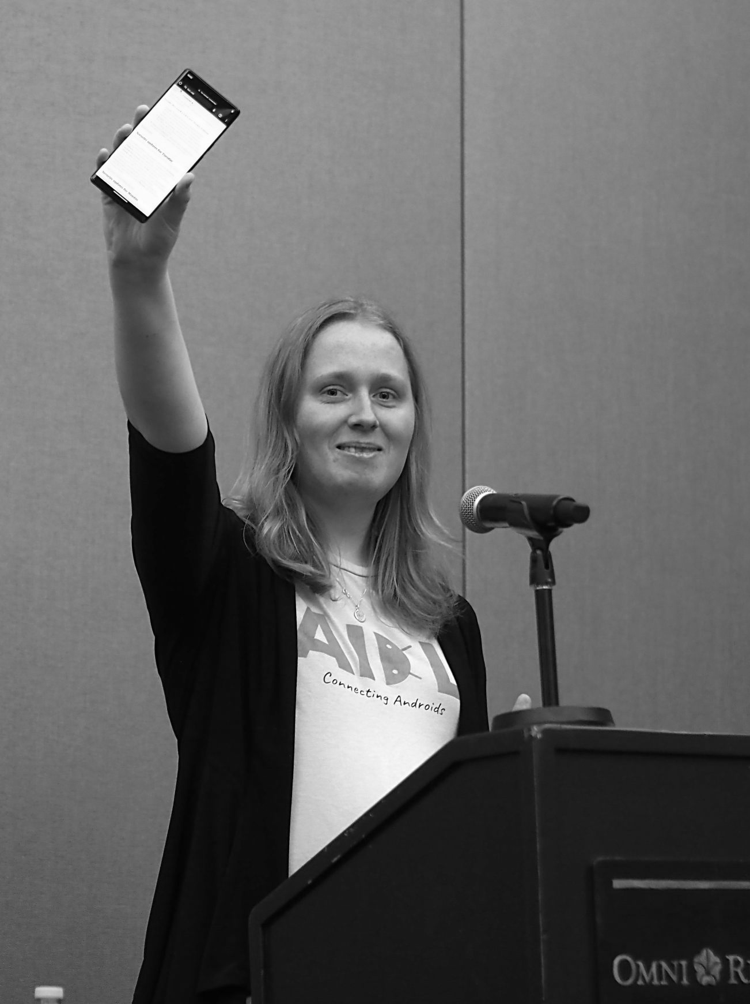
time to
introduce
bug
Elimination
Rewriting Binder from C to Rust
Attack surface reachable even from sandboxed processes.
Alice Ryhl at LPC 2023

Slide 123
time to
introduce
bug
Elimination
Rewriting Binder from C to Rust
Complexity
Tech Debt
Security
Alice Ryhl at LPC 2023

Slide 124
time to
introduce
bug
Elimination
Rewriting Binder from C to Rust
"It prevents mistakes with ref counting, locking, bounds checking, and also does a lot to reduce the complexity of error handling."
Alice Ryhl at LPC 2023

Slide 125
time to
find vuln
Substitution
Replace one dangerous hazard
for another
less dangerous hazard

Slide 126

time to
find vuln
Substitution
Use After Freedom
MiraclePtr (BackupRefPtr): Preventing Exploitation of Use-After-Free Bugs
Sergei Glazunov from PZ

Slide 127
time to
find vuln
Substitution
class A { ... };
class B {
B(A* a) : a_(a) {}
void doSomething() { a_->doSomething(); }
A* a_;
};
std::unique_ptr<A> a = std::make_unique<A>();
std::unique_ptr<B> b = std::make_unique<B>(a.get());
a = nullptr;
b->doSomething();

Slide 128
time to
find vuln
Substitution
class A { ... };
class B {
B(A* a) : a_(a) {}
void doSomething() { a_->doSomething(); }
A* a_;
};
std::unique_ptr<A> a = std::make_unique<A>();
std::unique_ptr<B> b = std::make_unique<B>(a.get());
a = nullptr; // free happens here
b->doSomething(); // use after free!

Slide 129
time to
find vuln
Substitution
class A { ... };
class B {
B(A* a) : a_(a) {}
void doSomething() { a_->doSomething(); }
raw_ptr<A> a_; // raw_ptr -> MiraclePtr (BackupRefPtr)
};
std::unique_ptr<A> a = std::make_unique<A>();
std::unique_ptr<B> b = std::make_unique<B>(a.get());
a = nullptr;
b->doSomething();

Slide 130
time to
find vuln
Substitution
class A { ... };
class B {
B(A* a) : a_(a) {}
void doSomething() { a_->doSomething(); }
raw_ptr<A> a_; // raw_ptr -> MiraclePtr (BackupRefPtr)
};
std::unique_ptr<A> a = std::make_unique<A>();
std::unique_ptr<B> b = std::make_unique<B>(a.get());
a = nullptr; // free is delayed because refcount is > 0
b->doSomething(); // use-after-free is neutralized

Slide 131
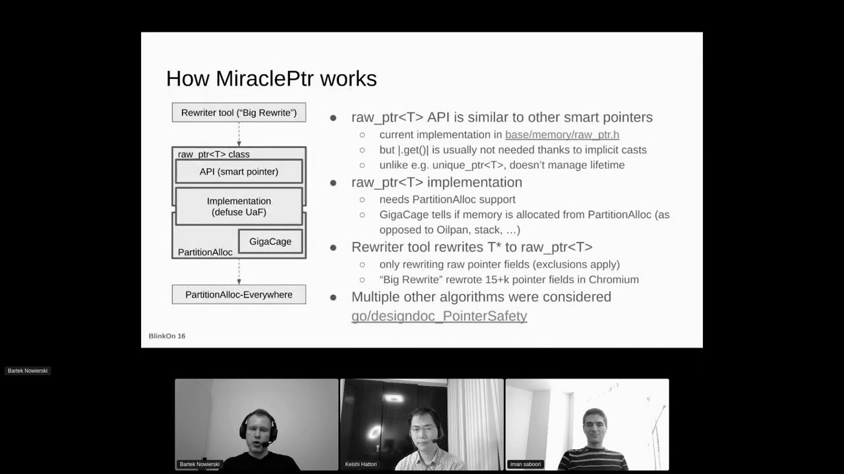
time to
find vuln
Substitution
Use After Freedom
Crash
Memory Corruption
Memory Leak

Slide 132
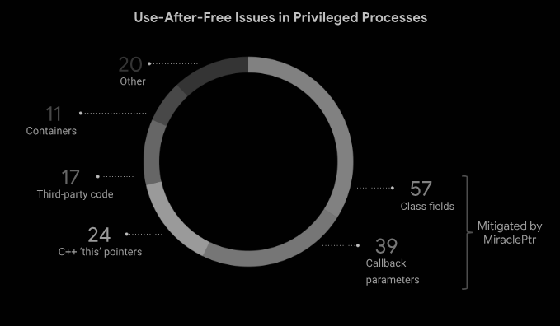
time to
find vuln
Substitution
57%

Slide 133

time to
exploit
Isolation
Protect system from the effects of a hazard

Slide 134

time to
exploit
Isolation
The V8 Sandbox is a new security mechanism designed to prevent memory corruption in V8 from impacting other memory in the process.
Samuel Groß from v8

Slide 135
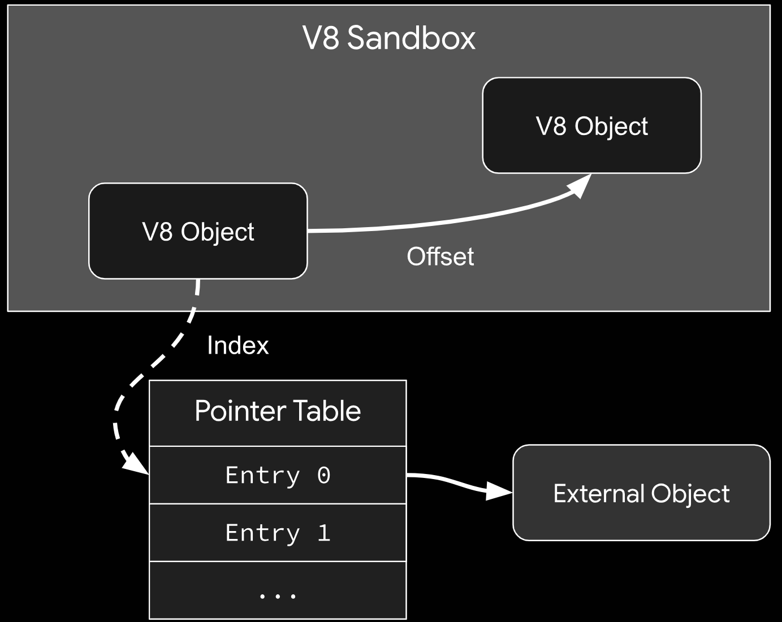
time to
exploit
Isolation
Samuel Groß from v8

Slide 136

Policy
Discourage, but still optionally permit hazards given enough warning

Slide 137
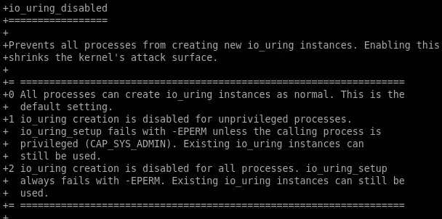
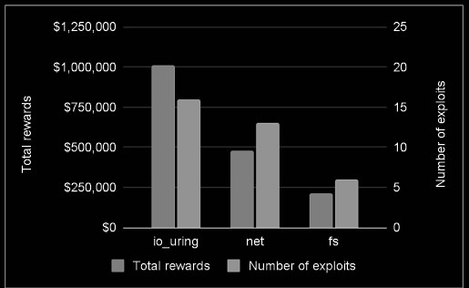


Policy
Matteo Rizzo
Tamás Koczka

Slide 138
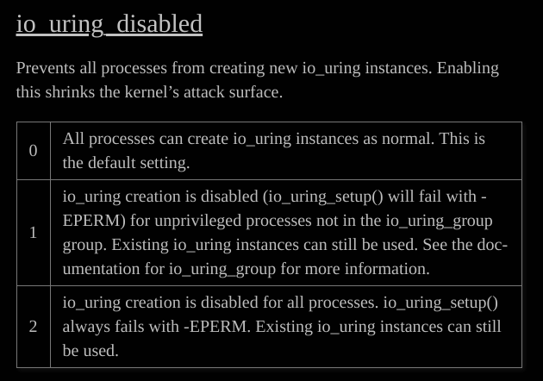
Policy
Matteo Rizzo
Tamás Koczka

Slide 139
shelf life
Damage Control

Slide 140
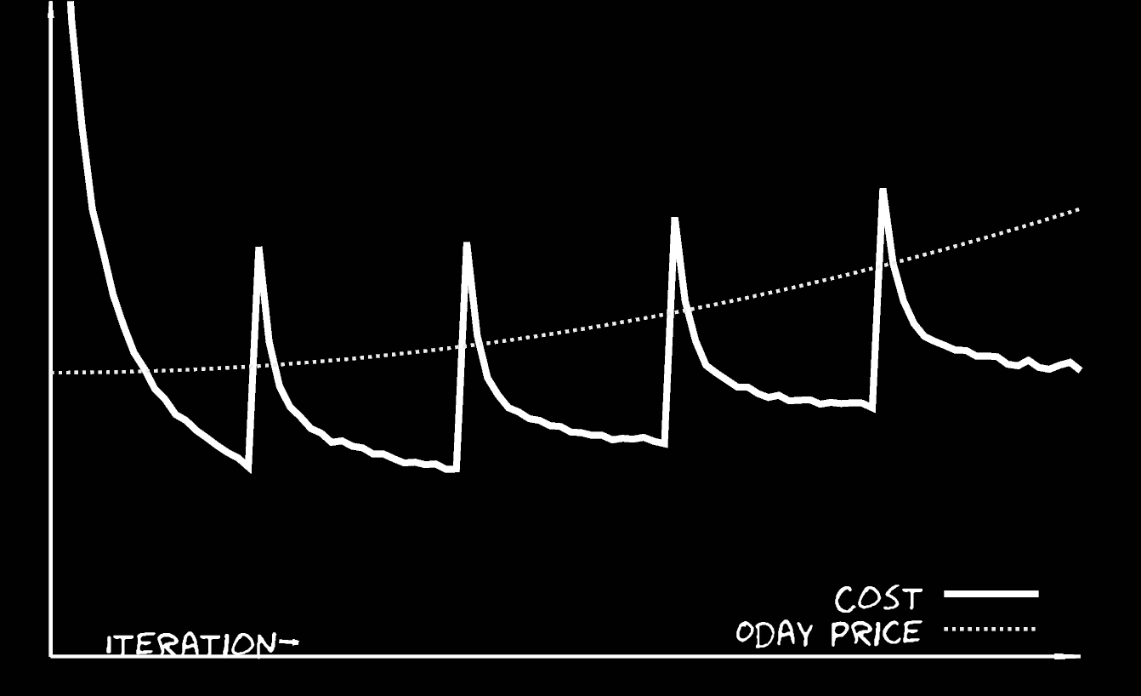
shelf life
Damage Control
exploit dev & maintenance cost
time to exploit
shelf life
time to implement mitigation
time to deploy mitigation
Mitigation Deployed
Repeated vs. single-round games in security Halvar Flake, BSides Zurich 2017
Notes:
https://docs.google.com/presentation/d/1y_R6Lkby-10LIIzFMnF4wqzqPWD-eh5RemWy31y4UjE/edit#slide=id.g26af5e9965_0_188

Slide 141
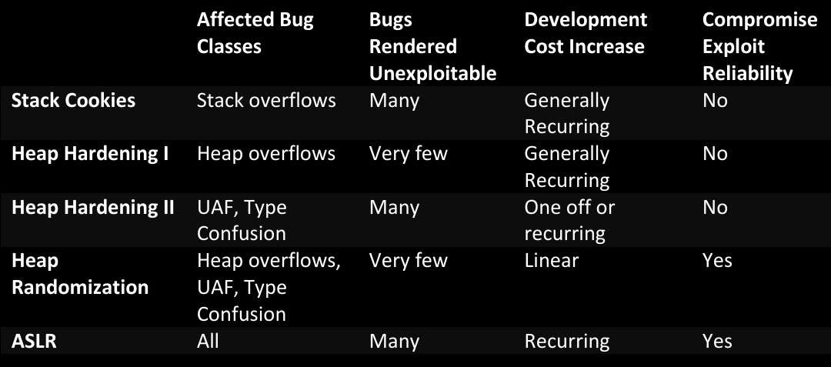
shelf life
Damage Control
The (Memory) Safety Dance Mark Dowd, SAS 2017
Notes:
https://github.com/mdowd79/presentations/blob/main/sas2017-dowd-final.pdf

Slide 142

shelf life
Damage Control
https://github.com/thejh/linux/blob/slub-virtual/MITIGATION_README
Mitigates against flexible data structures
Structs with variable size go on their own slab that isn't shared with provably-fixed-size objects
flex
non-flex
...
...
pipe_buffer
socket
msg_msg
creds
poll_list
xfrm_policy
xattr
xfrm_policy
msg_msg
socket
poll_list
tls_context
xattr
net

Slide 143
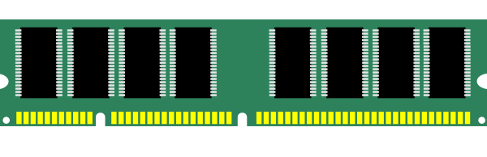
shelf life
Damage Control
https://github.com/thejh/linux/blob/slub-virtual/MITIGATION_README
Mitigates against cross-cache attacks
Virtual addresses for slabs are never reused
So you are forced to have vuln, attack and victim objects on the same slab (if the memory safety violation happens in a slab allocation)
reserve slab1
Virtual Address | Physical Address
0xFFFFFF0123456 | 0x0000031234567890

Slide 144
shelf life
Damage Control
https://github.com/thejh/linux/blob/slub-virtual/MITIGATION_README
Mitigates against cross-cache attacks
Virtual addresses for slabs are never reused
So you are forced to have vuln, attack and victim objects on the same slab (if the memory safety violation happens in a slab allocation)
reserve slab1
Virtual Address | Physical Address
0xFFFFFF0123456 | 0x0000031234567890
free slab1
Virtual Address | Physical Address
0xFFFFFF0123456 | FAULT PAGE

Slide 145
shelf life
Damage Control
https://github.com/thejh/linux/blob/slub-virtual/MITIGATION_README
Mitigates against cross-cache attacks
Virtual addresses for slabs are never reused
So you are forced to have vuln, attack and victim objects on the same slab (if the memory safety violation happens in a slab allocation)
reserve slab1
Virtual Address | Physical Address
0xFFFFFF0123456 | 0x0000031234567890
free slab1
Virtual Address | Physical Address
0xFFFFFF0123456 | FAULT PAGE
reserve slab2
Virtual Address | Physical Address
0xFFFFFF789ABCD | 0x0000031234567890

Slide 146
shelf life
Damage Control
https://github.com/thejh/linux/blob/slub-virtual/MITIGATION_README
Mitigates against linear out-of-bounds
Guard pages around every slab
slab1
slab2
slab3
page
guard page
page1
page2
guard page
page

Slide 147


shelf life
Damage Control
https://github.com/thejh/linux/blob/slub-virtual/MITIGATION_README
Mitigates against flexible data structures
Structs with variable size go on their own slab that isn't shared with provably-fixed-size objects
Mitigates against cross-cache attacks
Virtual addresses for slabs are never reused
So you are forced to have vuln, attack and victim objects on the same slab (if the memory safety violation happens in a slab allocation)
Mitigates against linear out-of-bounds
Guard pages around every slab
* Mitigates against freelist corruption
Ensure that the freelist pointer is inside the same slab
Jann Horn
Matteo Rizzo

Slide 148
Offense Goals:
Defense Goals:
time to find bug
time to deploy
time to fix
time to find vuln
time to introduce bug
time to find bug
time to find vuln
time to exploit
Bug Introduced
shelf life
Fix Deployed
time to implement mitigation
time to deploy mitigation
Mitigation Deployed
Time

Slide 149
There are no more bonus slides

